Slide 1
5
APPLICATIONS OF INTEGRATION
Copyright © Cengage Learning. All rights reserved.

Slide 2
5.7
Parametric Equations and Polar Coordinates
Copyright © Cengage Learning. All rights reserved.

Slide 3
Parametric Curves
Copyright © Cengage Learning. All rights reserved.

Slide 4
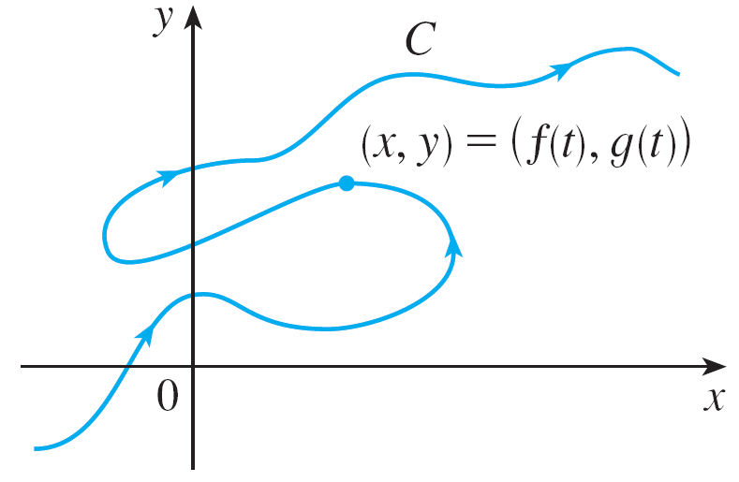
Parametric Curves
Imagine that a particle moves along the curve C shown in Figure 1.
It is impossible to describe C by an equation of the form y = f (x) because C fails the Vertical Line Test.
Figure 1

Slide 5

Parametric Curves
But the x- and y-coordinates of the particle are functions of time and so we can write x = f (t) and y = g(t).
Such a pair of equations is often a convenient way of describing a curve and gives rise to the following definition.
Suppose that x and y are both given as functions of a third variable t (called a parameter) by the equations
(called parametric equations).

Slide 6
Parametric Curves
Each value of t determines a point (x, y), which we can plot in a coordinate plane.
As t varies, the point (x, y) = (f (t), g(t)) varies and traces out a curve C, which we call a parametric curve.
The parameter t does not necessarily represent time and, in fact, we could use a letter other than t for the parameter.
But in many applications of parametric curves, t does denote time and therefore we can interpret
(x, y) = (f (t), g(t)) as the position of a particle at time t.

Slide 7

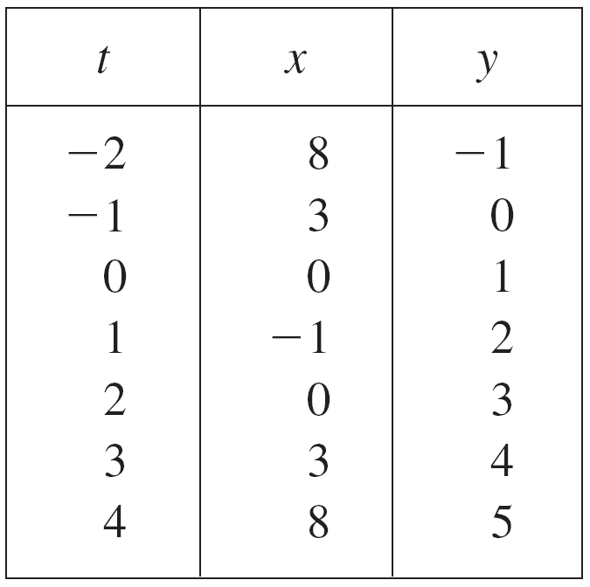
Example 1
Sketch and identify the curve defined by the parametric equations
Solution:
Each value of t gives a point on the curve, as shown in the table.

Slide 8
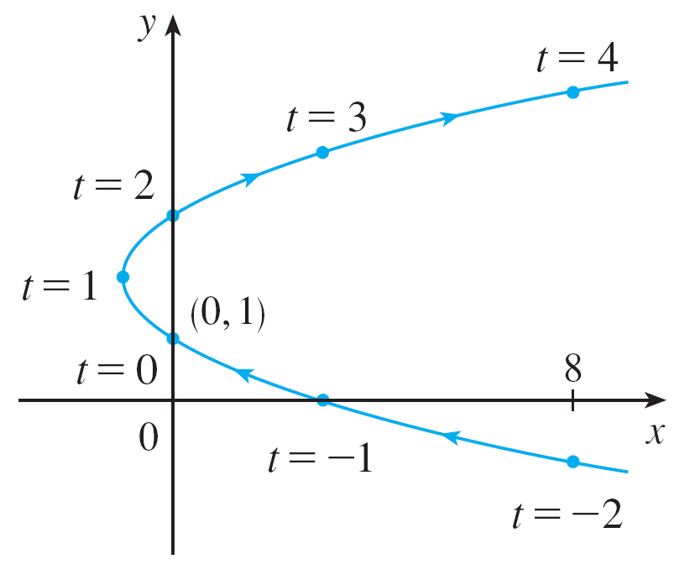
Example 1 – Solution
cont’d
For instance, if t = 0, then x = 0, y = 1 and so the corresponding point is (0, 1). In Figure 2 we plot the points (x, y) determined by several values of the parameter t and we join them to produce a curve.
Figure 2

Slide 9
Calculus with Parametric Curves
Copyright © Cengage Learning. All rights reserved.

Slide 10
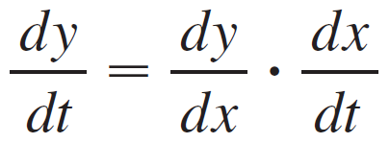
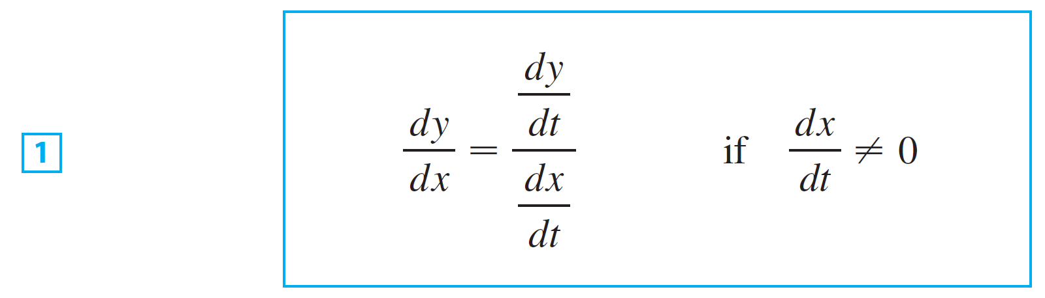
Tangents
Suppose f and g are differentiable functions and we want to
find the tangent line at a point on the parametric curve
x = f (t), y = g(t) where y is also a differentiable function of x.
Then the Chain Rule gives
If dx/dt ≠ 0, we can solve for dy/dx:

Slide 11
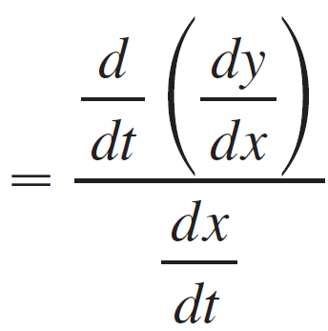
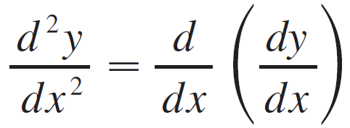
Tangents
It is also useful to consider d ²y/dx². This can be found by replacing y by dy/dx in Equation 1:

Slide 12




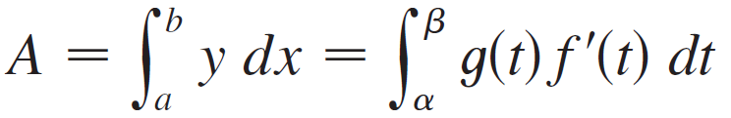
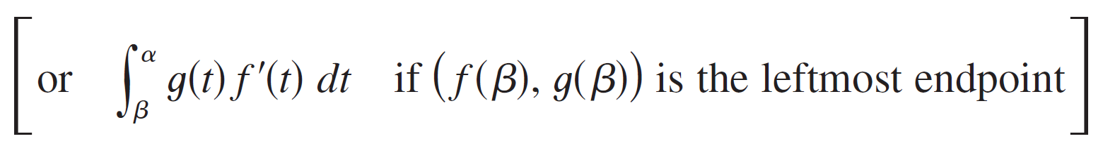
Areas
We know that the area under a curve from a to b is
where
If the curve is given by parametric equations
and is traversed once as t increases from α to β, then we can adapt the earlier formula by using the Substitution Rule for Definite Integrals as follows:

Slide 13


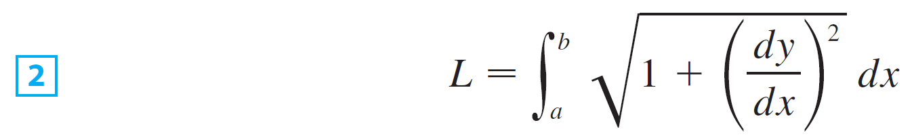

Arc Length
We already know how to find the length L of a curve C given in the form
We have known that if F ′ is continuous, then
Suppose that C can also be described by the parametric equations where

Slide 14
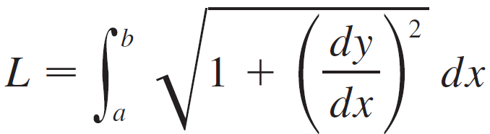
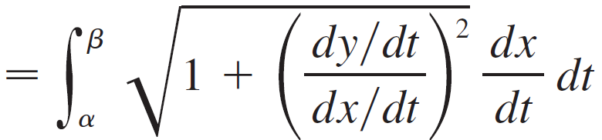
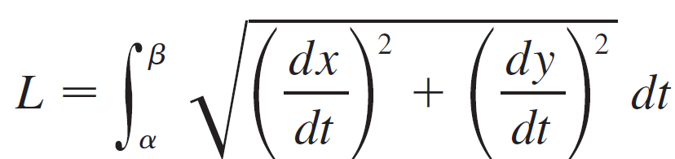

Arc Length
This means that C is traversed once, from left to right, as t increases from and
Putting Formula 1 into Formula 2 and using the Substitution Rule, we obtain
Since dx/dt > 0, we have

Slide 15
Polar Coordinates
Copyright © Cengage Learning. All rights reserved.

Slide 16
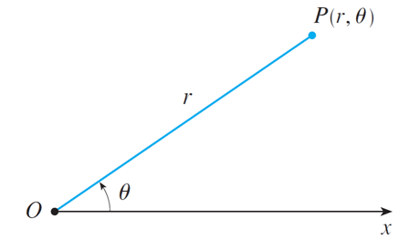
Polar Coordinates
We choose a point in the plane that is called the pole (or origin) and is labeled O. Then we draw a ray (half-line) starting at O called the polar axis. This axis is usually drawn horizontally to the right and corresponds to the positive x-axis in Cartesian coordinates.
If P is any other point in the plane, let r be the distance from O to P and let θ be the angle (usually measured in radians) between the polar axis and the line OP as in Figure 1.
polar axis
Figure 1

Slide 17
Polar Coordinates
Then the point P is represented by the ordered pair (r, θ ) and r, θ are called polar coordinates of P.
We use the convention that an angle is positive if measured in the counterclockwise direction from the polar axis and negative in the clockwise direction.
If P = O, then r = 0 and we agree that (0, θ ) represents the pole for any value of θ.

Slide 18
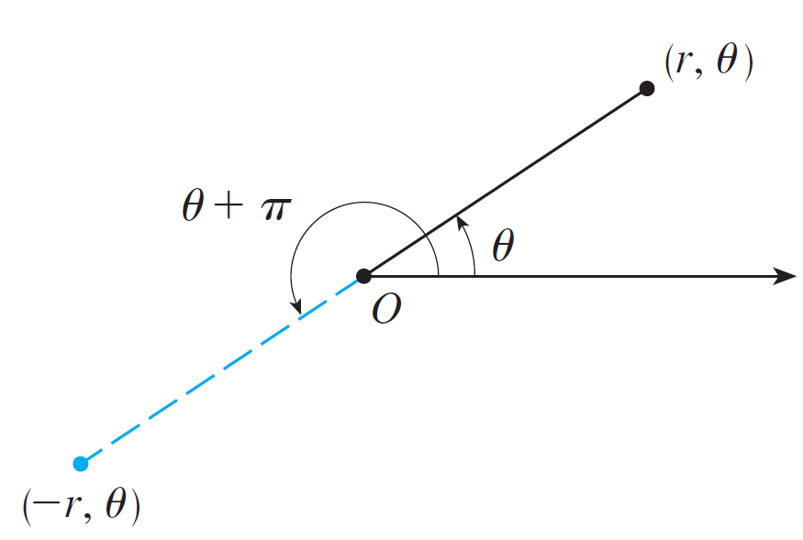
Polar Coordinates
We extend the meaning of polar coordinates (r, θ ) to the case in which r is negative by agreeing that, as in Figure 2, the points (–r, θ ) and (r, θ ) lie on the same line through O and at the same distance | r | from O, but on opposite sides of O.
Figure 2

Slide 19
Polar Coordinates
If r > 0, the point (r, θ ) lies in the same quadrant as θ ; if r < 0, it lies in the quadrant on the opposite side of the pole.
Notice that (–r, θ ) represents the same point as (r, θ + π ).
In the polar coordinate system each point has many representations.

Slide 20
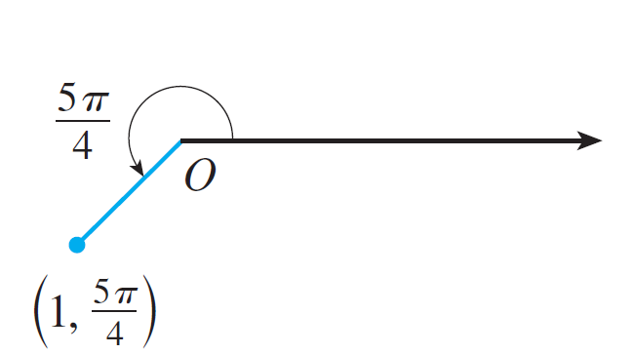
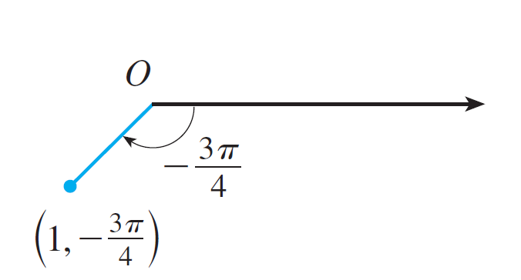
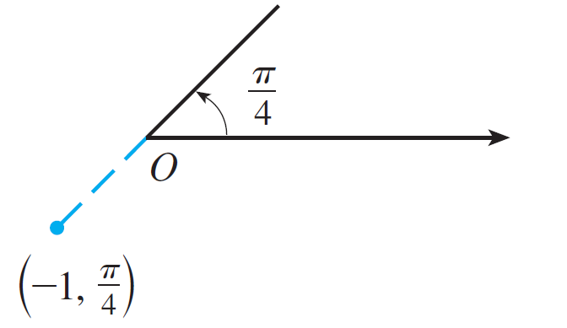
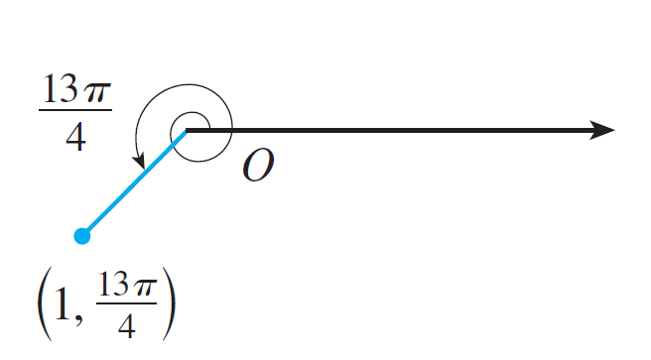
Polar Coordinates
For instance, the point (1, 5π/4) could be written as (1, –3π/4) or (1, 13π/4) or (–1, π/4). (See Figure 4.)
Figure 4

Slide 21
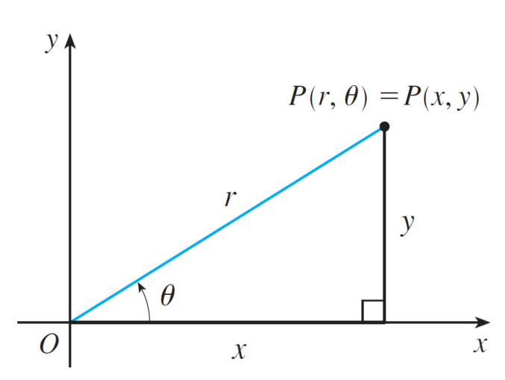
Polar Coordinates
In fact, since a complete counterclockwise rotation is given by an angle 2π, the point represented by polar coordinates (r, θ ) is also represented by
where n is any integer.
The connection between polar
and Cartesian coordinates can
be seen from Figure 5, in which
the pole corresponds to the origin
and the polar axis coincides with the
positive x-axis.
Figure 5

Slide 22
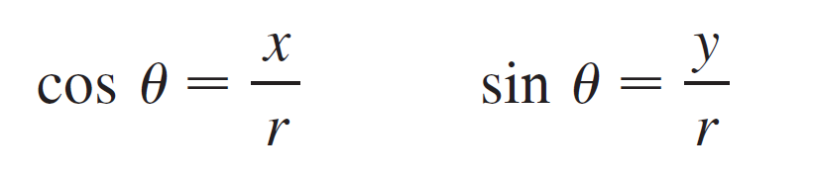

Polar Coordinates
If the point P has Cartesian coordinates (x, y) and polar coordinates (r, θ ), then, from the figure 5, we have
and so
Equations 1 allow us to find the Cartesian coordinates of a point when the polar coordinates are known.

Slide 23
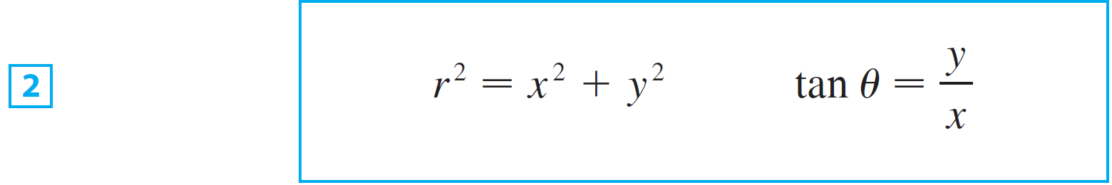
Polar Coordinates
To find r and θ when x and y are known, we use the equations
which can be deduced from Equations 1 or simply read
from Figure 5.
Figure 5

Slide 24
Polar Curves
The graph of a polar equation r = f (θ ), or more generally F(r, θ ) = 0, consists of all points P that have at least one polar representation (r, θ ) whose coordinates satisfy the equation.

Slide 25
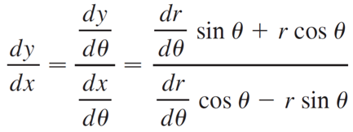

Tangents to Polar Curves
To find a tangent line to a polar curve r = f (θ ) we regardθ as a parameter and write its parametric equations as
Then slopes of parametric curves are given by:

Slide 26
Areas and Lengths in Polar Coordinates
Copyright © Cengage Learning. All rights reserved.

Slide 27
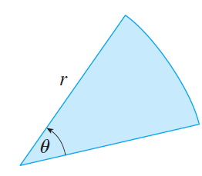
Areas and Lengths in Polar Coordinates
In this section we develop the formula for the area of a region whose boundary is given by a polar equation. We need to use the formula for the area of a sector of a circle
where, as in Figure 1, r is the radius
and θ is the radian measure of the
central angle.
Figure 1

Slide 28
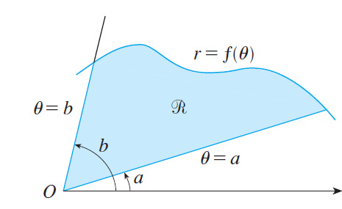
Areas and Lengths in Polar Coordinates
Let be the region, illustrated in Figure 2, bounded by the polar curve r = f (θ) and by the rays θ = a and θ = b, where f is a positive continuous function and where 0 < b – a ≤ 2π.
Figure 2

Slide 29
Areas and Lengths in Polar Coordinates
We divide the interval [a, b] into subintervals with endpoints θ₀, θ₁, θ₂, . . . , θ_{n} and equal width Δθ.
The rays θ = θ_{i} then divide into n smaller regions with central angle Δθ = θ_{i} – θ_{i − 1}.

Slide 30


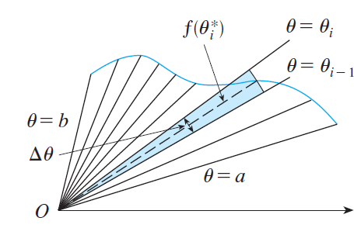
Areas and Lengths in Polar Coordinates
If we choose in the ith subinterval [θ_{i −1}, θ_{i}], then the area ΔA_{i} of the ith region is approximated by the area of the sector of a circle with central angle Δθ and radius
(See Figure 3.)
Figure 3

Slide 31





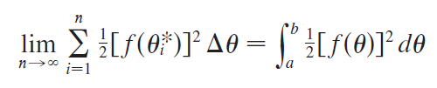
Areas and Lengths in Polar Coordinates
Thus from Formula 1 we have
and so an approximation to the total area A of is
It appears from Figure 3 that the approximation in improves as n → . But the sums in are Riemann sums for the function so

Slide 32
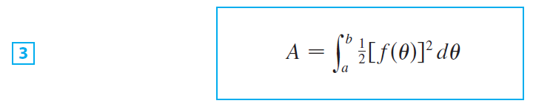
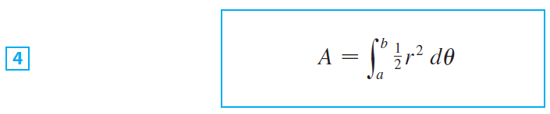
Areas and Lengths in Polar Coordinates
It therefore appears plausible (and can in fact be proved) that the formula for the area A of the polar region is
Formula 3 is often written as
with the understanding that r = f (θ).

Slide 33
Areas and Lengths in Polar Coordinates
Note the similarity between Formulas 1 and 4.

Slide 34
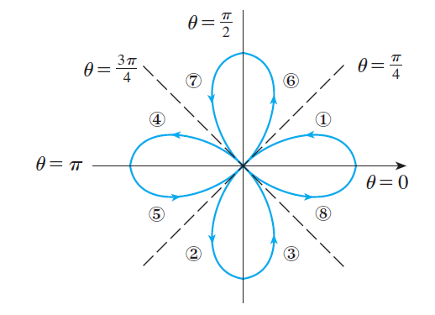
Example 1
Find the area enclosed by one loop of the four-leaved rose r = cos 2θ.
Solution:
The sketch of the curve r = cos 2θ is given below.
Four-leaved rose r = cos 2θ

Slide 35
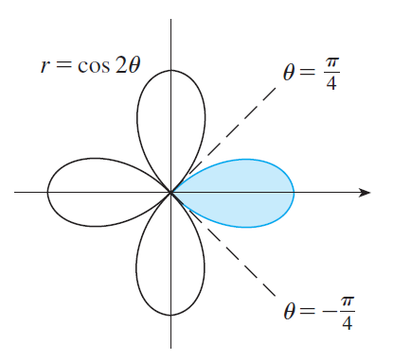
Example 1 – Solution
cont’d
Notice from Figure 4 that the region enclosed by the right loop is swept out by a ray that rotates from θ = –π /4 to
θ = π /4.
Figure 4

Slide 36


Example 1 – Solution
cont’d
Therefore Formula 4
gives

Slide 37
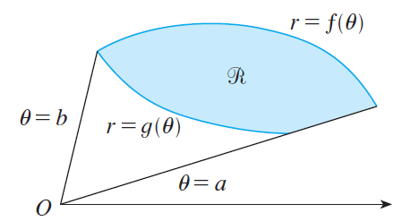
Areas and Lengths in Polar Coordinates
In general, let be a region, as illustrated in Figure 6, that is bounded by curves with polar equations r = f (θ ), r = g(θ ), θ = a, and θ = b, where f (θ ) ≥ g(θ ) ≥ 0 and 0 < b – a ≤ 2π.
Figure 6

Slide 38
Areas and Lengths in Polar Coordinates
The area A of is found by subtracting the area inside
r = g(θ ) from the area inside r = f (θ ), so using Formula 3
we have

Slide 39
Arc Length

Slide 40
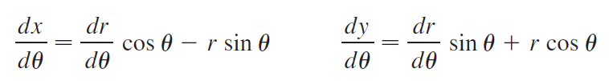
Arc Length
To find the length of a polar curve r = f (θ ), a ≤ θ ≤ b, we regard θ as a parameter and write the parametric equations of the curve as
Using the Product Rule and differentiating with respect to θ, we obtain

Slide 41
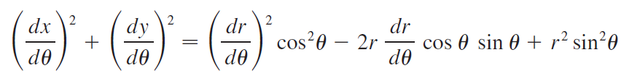
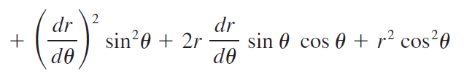

Arc Length
So, using cos²θ + sin²θ = 1 , we have

Slide 42
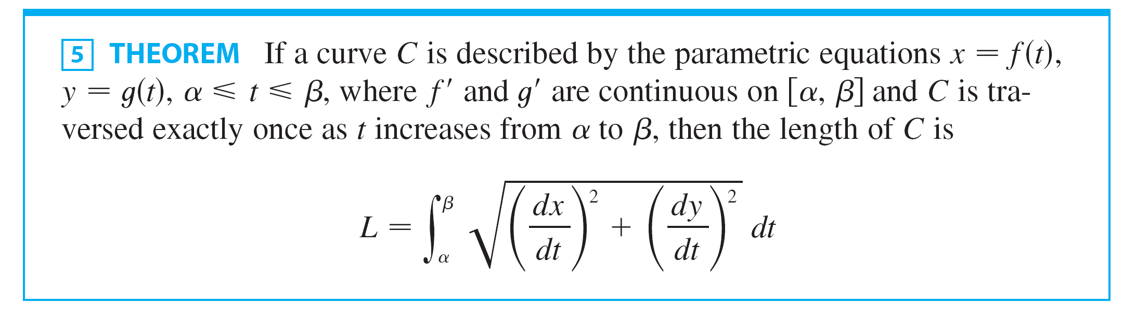
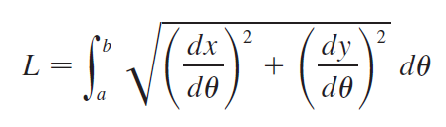
Arc Length
Now to find the arc length L of a curve C.
Assuming that f ′ is continuous, we can use the above formula to write the arc length as

Slide 43
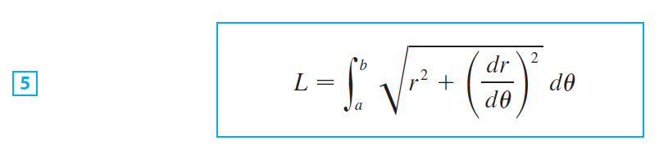
Arc Length
Therefore the length of a curve with polar equation
r = f (θ ), a ≤ θ ≤ b, is

Slide 44
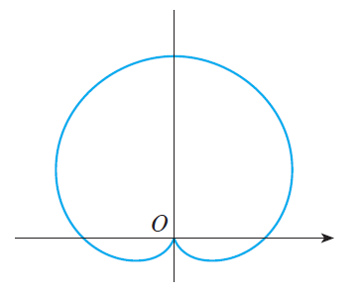
Example 4
Find the length of the cardioid r = 1 + sin θ.
Solution:
The cardioid is shown in Figure 8.
r = 1 + sin θ
Figure 8

Slide 45
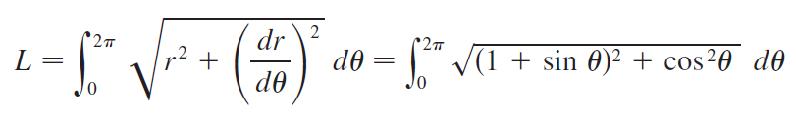

Example 4 – Solution
cont’d
Its full length is given by the parameter interval 0 ≤ θ ≤ 2π , so Formula 5
gives

Slide 46
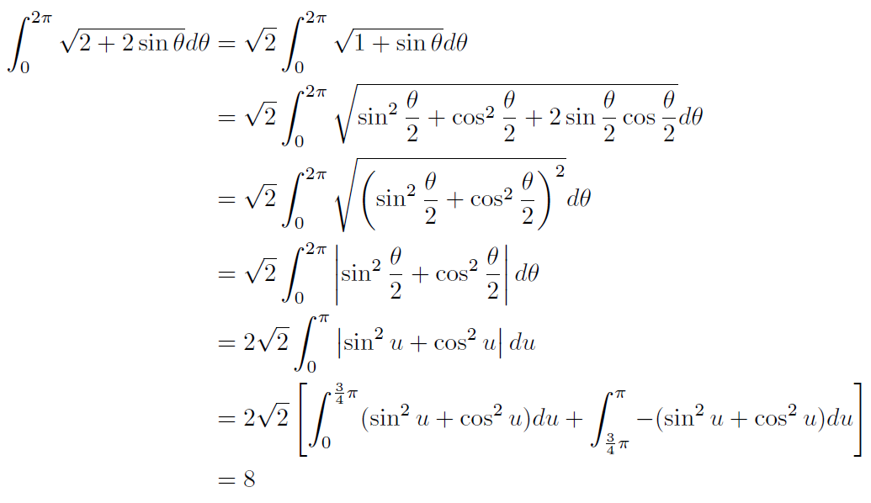

Example 4 – Solution
cont’d
We find that the length of the cardioid is L = 8.

